Slide 1


COVID-19 Cases & Vaccination Rates of Age and Ethnic Demographics
Team Name: Mamba Mentality
Team Members:
Musab Kazi, mkazi3@uic.edu, mkazi3
Talha Khan, mkhan387@uic.edu, BlackPanther
Daniyal Khokhar, dkhokh2@uic.edu, DaniyalSKKR
Ameen Rahman, arahm20@uic.edu, ARahm20
Ameer Shehayber, asheh3@uic.edu, Ashehayber
GitHub Project Repository: https://github.com/uic-cs418/Mamba-Mentality

Slide 2
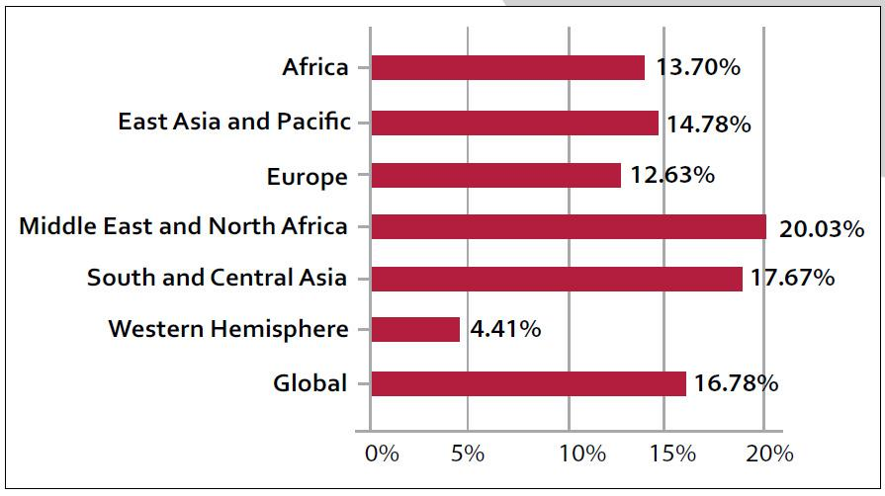
Problem
While COVID-19 quickly spread across Chicago, not everyone made the decision to receive vaccinations against the virus
We want to understand the relationship between COVID-19 cases and vaccinated individuals of various age and ethnic groups
We hypothesize that the increase in COVID-19 cases increased the count of vaccinations, albeit at significantly lower rates among minorities
Developing such an understanding allows for more effective advertisement and initiatives to target demographics whos vaccination rates do not significantly increase when more COVID-19 cases are prevalent

Slide 3

Data
Dataset: Influenza, COVID-19, RSV, and Other Respiratory Virus Laboratory Surveillance
Source: https://catalog.data.gov/dataset/influenza-covid-19-rsv-and-other-respiratory-virus-laboratory-surveillance
The raw dataset contains 2276 rows
Data from 2010-2011 - 2018-2019 (approximately 468 rows) would need to be removed because Influenza was the only virus tracked during that time period
The dataset includes the total number of tests, the number of positive cases, and the percentage of positive cases on a weekly basis
The data is accessible and does not require any further collection
Dataset: COVID-19 Vaccinations by Age and Race-Ethnicity - Historical
Source: https://catalog.data.gov/dataset/covid-19-vaccinations-by-age-and-race-ethnicity
The raw dataset contains 7600 rows
Data needs to be reorganized because it is currently not easily read with the data not being in chronological order
The dataset includes the population size, the amount and percentage who have received their first dose, who have completed their vaccine series, who are boosted, and who have received bivalent
The data is accessible and does not require any further collection

Slide 4
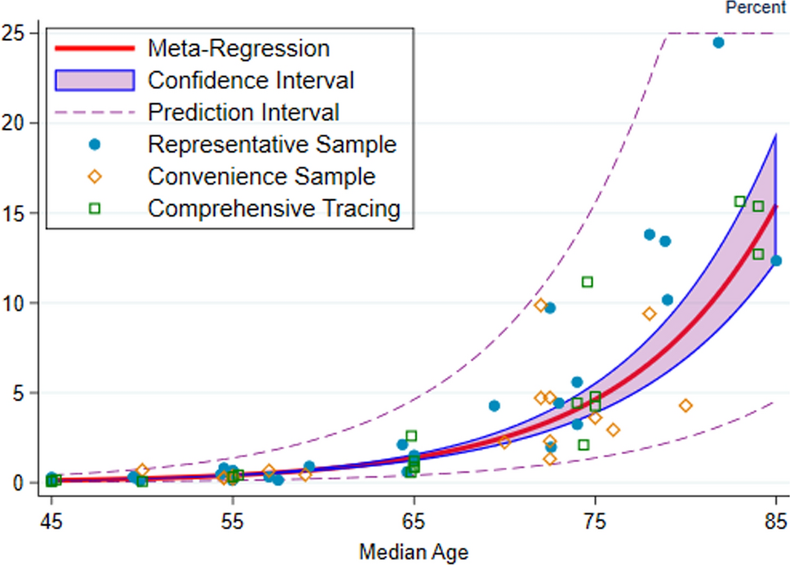
Solutions
Temporal Analysis:
Examining the trends over time for each demographic’s vaccination rates by plotting the weekly or cumulative lab positive rates for COVID-19 to identify any significant changes by week
Investigating if there are changes in the seasonality of vaccination rates
Comparative Analysis:
Comparison of Prevalence: Compare the vaccination rates for COVID-19 per demographic throughout the COVID-19 pandemic
Impact on Specific Demographics: Focus on specific demographics to understand how their vaccination rates were affected by the presence of COVID-19

Slide 5
Backup Data: Unemployment
https://www.ers.usda.gov/data-products/county-level-data-sets/county-level-data-sets-download-data/

